Slide 1
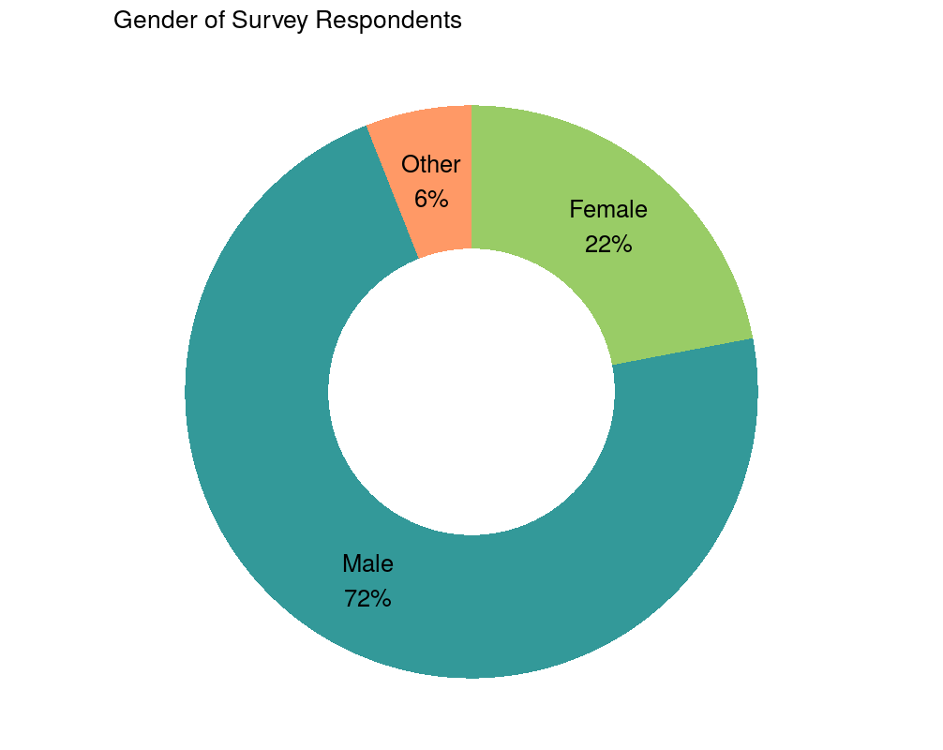
MENTAL HEALTH IN TECH SURVEY

Slide 2
PROBLEM DEFINITION
The problem in the context of mental health in the tech industry is multifaceted. It includes issues such as high levels of stress, burnout, imposter syndrome, work-life imbalance, and stigma surrounding mental health. Employees in the tech sector often face intense workloads, tight deadlines, and a competitive environment, which can lead to mental health challenges.

Slide 3
Design Thinking Approach
Empathize:
Conduct surveys and interviews with tech industry professionals to understand their mental health challenges, triggers, and coping mechanisms. Gather data on the prevalence of mental health issues in the tech industry and their impact on productivity and well-being.

Slide 4
Define:
Define specific problem areas within mental health, such as stress management, work-life balance, or stigma reduction. Create user personas to represent different segments of the tech workforce, considering factors like role, experience level, and personal circumstances.

Slide 5
Ideate:
Brainstorm potential solutions and interventions to address the identified problems. Encourage diverse perspectives from tech employees, mental health experts, and HR professionals.
Prototype:
Develop prototypes of mental health support programs or initiatives, such as employee assistance programs, peer support networks, or stress reduction workshops. Test these prototypes with a small group of tech industry professionals to gather feedback.

Slide 6
Test:
Collect feedback from the pilot tests and iterate on the prototypes. Assess the effectiveness of the interventions in improving mental health outcomes and overall job satisfaction.
Implement:
Roll out the refined solutions on a larger scale, making them accessible to a broader range of tech employees. Develop communication strategies to promote mental health awareness and encourage participation.

Slide 7
Evaluate:
Continuously monitor and evaluate the impact of the implemented solutions on mental health metrics, such as stress levels, absenteeism, and employee turnover. Make necessary adjustments and improvements based on ongoing feedback and data analysis.
Iterate:
Use a cyclical design thinking approach to continuously refine and enhance mental health support initiatives in the tech industry.

Slide 8
Remember that mental health is a complex and evolving issue, so an ongoing commitment to design thinking and adaptability is crucial to address the unique challenges faced by tech professionals effectively.

